Slide 1
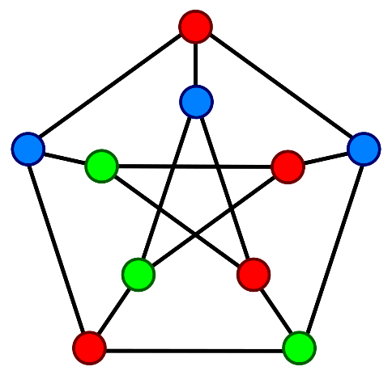
Graph Theory and Management Science:
Euler Paths and Circuits
Graph Theory and Management Science: Euler Paths and Circuits, by Peggy Mitchell Beauregard, is licensed under a
Creative Commons Attribution-ShareAlike 4.0 International License.

Slide 2
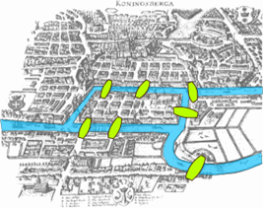
Euler Paths and Circuits
The Pregel River meanders through the Prussian city of Konigsberg, crossed by seven bridges connecting the land masses, as shown in the picture.
For the perfect evening date, couples would wander across the bridges.
Leonard Euler, a well known mathematician of the time, posed the question: “Is it possible to cross all of the bridges exactly once and return to where you started?”
Euler reduced the complicated map to a model which simplified the problem, called a graph.

Slide 3


Turning a map into a graph: Euler’s view of Konigsberg

Slide 4
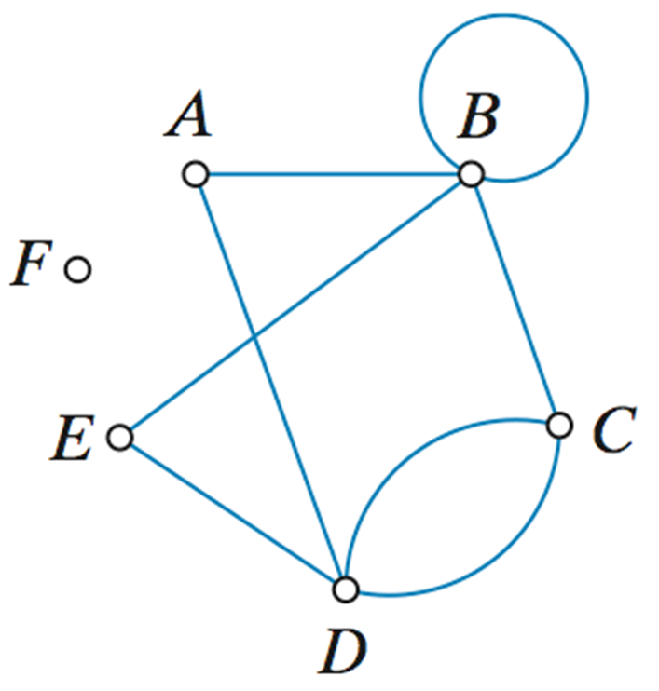
The language of graphs…
Vertices, vertex (dots)
Edges (lines)
A loop connects a vertex to itself. (BB)
Occasionally, we see an isolated vertex: not connected. (F)
Connected: all in one piece.
The edges of this graph, listed in random order, are AB, BC, CD, AD, DE, DE, EB, CD, and BB.

Slide 5
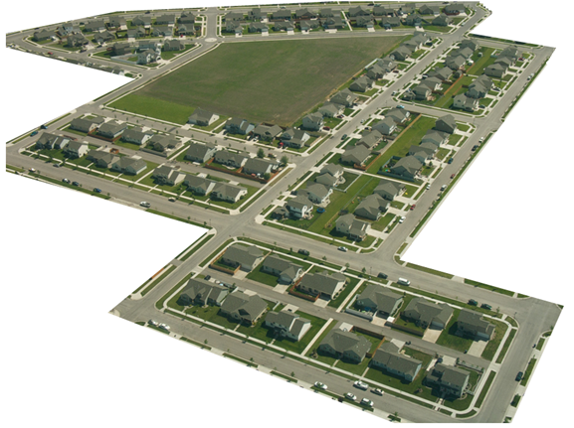
Here is a portion of a housing development from Missoula, Montana. As part of her job, the development’s lawn inspector has to walk down every street in the development making sure homeowners’ landscaping conforms to the community requirements.
Sam Beebe. http://www.flickr.com/photos/sbeebe/2850476641/, CC-BY
You might be able to imagine that this neighborhood would look a lot simpler without the complexities of the picture…

Slide 6

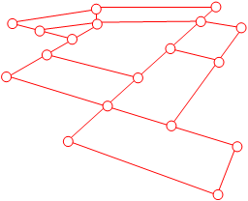
What do the vertices and edges represent?

Slide 7
If you put the vertices in a different layout, the graph would still be correct.
These two graphs are isomorphic, because they contain the same vertex set and edge set.

Slide 8
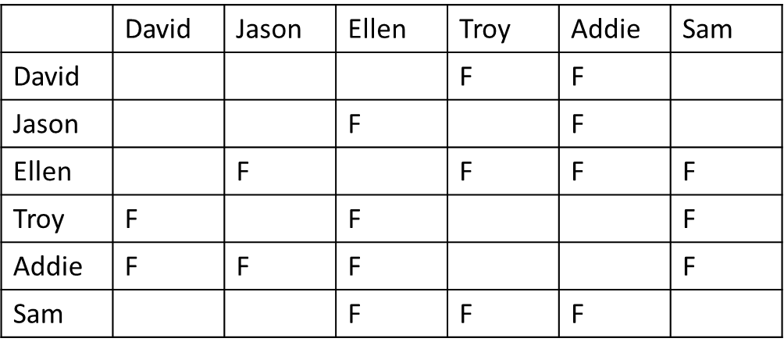
We can draw graphs to represent relationships, as well. The table below shows which students in a group are friends. Draw a graph to model the situation. Label the vertices with the first letter of each student, and draw an edge between two vertices if the students are friends.

Slide 9
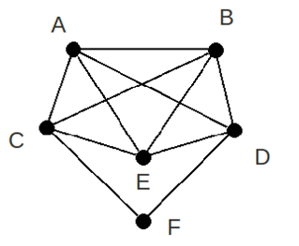
Practice:
List the edge set for the graph.
List the vertex set.
Two vertices are adjacent if they are joined by an edge.
Which vertices are adjacent to vertex E?
Two edges are adjacent if they share a common vertex. Name ALL edges adjacent to CF.
The degree of a vertex is the number of edges meeting at that vertex. Label each of the vertices with their degree, and classify them as even or odd (based on if the number is even or odd).

Slide 10
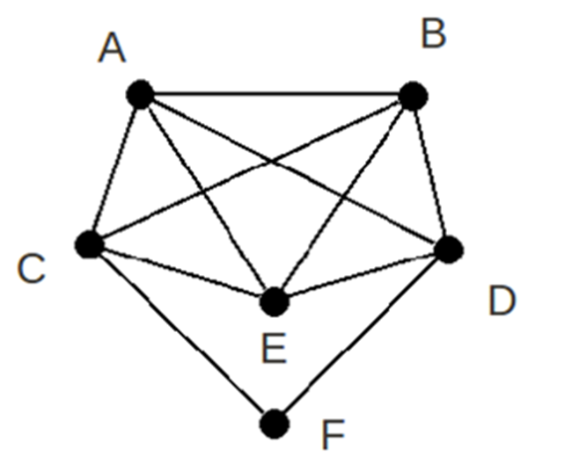
The degree of a vertex…Even or Odd?
The degree of a vertex is the number of edges meeting at that vertex.
Label each of the vertices with their degree, and classify them as even or odd (based on if the number is even or odd).
Simple, right? Simple, but important…

Slide 11
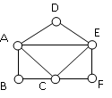
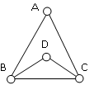
Unicursal drawings…Can you trace it without lifting your pencil? Does it matter where you start?

Slide 12
A few more definitions from Euler…
An Euler path is a path that uses every edge in a graph with no repeats. Being a path, it does not have to return to the starting vertex.
An Euler circuit is a circuit that uses every edge in a graph with no repeats. Being a circuit, it must start and end at the same vertex.
A graph is Non-traversable if you cannot trace each edge exactly once, without repeats and without missing any.

Slide 13
Count the degree of each vertex. EP, EC or NT? Can we find a pattern?
2.
3.
4.
1.
6.
7.
8.
5.

Slide 14
Euler’s Theorems
A graph will contain an Euler circuit if all vertices have even degree
A graph will contain an Euler path if it contains exactly two vertices of odd degree.
A graph is non-traversable if it has more than two vertices of odd degree.

Slide 15
Revisit the unicursal drawings… “Can you trace it without lifting your pencil” can be reworded as “does the graph have an Euler Path or Circuit?

Slide 16
How about this one?

Slide 17
Sources:
College Mathematics for Everyday Life, Kathryn Kozak et al (Coconino Community College) CC-BY-SA,
http://www.coconino.edu/resources/files/pdfs/academics/arts-and-sciences/MAT142/Chapter_6_GraphTheory.pdf
Math in Society, David Lippman, CC-BY-SA, http://www.opentextbookstore.com/mathinsociety/

