Slide 1
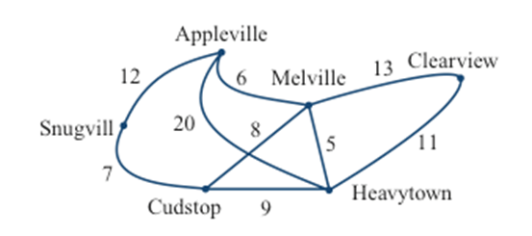
Graph Theory and Management Science: Networks and Spanning Trees
Graph Theory and Management Science: Networks and Spanning Trees, by Peggy Mitchell Beauregard, is licensed under a
Creative Commons Attribution-ShareAlike 4.0 International License.

Slide 2
What is the difference?
Between
a snowplow that has to trace every street
a traveler who must visit every city
a network of towns that must be connected by cables
The network of towns must be connected, but not in any particular order. The snowplow and traveler each go from one vertex to the next in order…they can’t “jump around”.

Slide 3
Facebook is one type of network…
You may be connected to someone on social media, but through another person. You don’t have to be connected to each person directly to still be connected. FB is an evolutionary network: it evolves and grows on its own.
At the opposite end of the spectrum from evolutionary networks are networks that are centrally planned and carefully designed to meet certain
goals and objectives. Often these types of networks are very expensive to build, and one of the primary considerations when designing such networks is minimizing their cost.
Examples: networks of roads, fiber-optic cable lines, rail lines, power lines…

Slide 4
We need to connect the all of the vertices, but not have a circuit (which would be redundant). We call this graph a spanning tree. It is not necessary to use all of the edges and many spanning trees may be possible. Trace a few here….

Slide 5
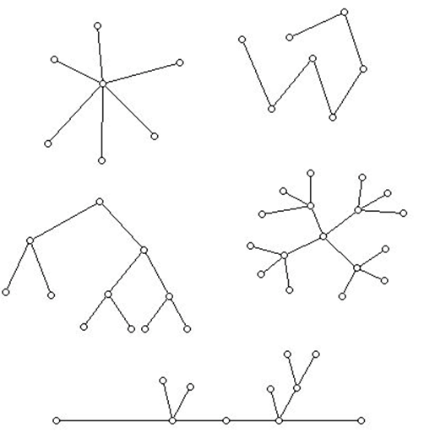
A couple more examples of trees. What do they have in common?

Slide 6
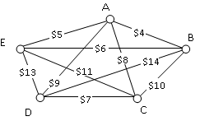
Consider: A company requires reliable internet and phone connectivity between their five offices (named A, B, C, D, and E for simplicity) in New York, so they decide to lease dedicated lines from the phone company. The phone company will charge for each link made. The costs, in thousands of dollars per year, are shown in the graph.
What we are looking for is the cheapest way to connect all of the sites (vertices). Again, we do not want a circuit..that would be redundant and cost extra money. We just want a path from any vertex to any other vertex.

Slide 7
A subgraph which contains all of the vertices but not all of the edges of the original graph and is connected is called a Spanning Tree.
Even more, we want the Minimum Cost Spanning Tree (MCST) or (MST).
Sometimes, we want a Maximum Cost Spanning Tree (MaxST). Pay attention to context….

Slide 8
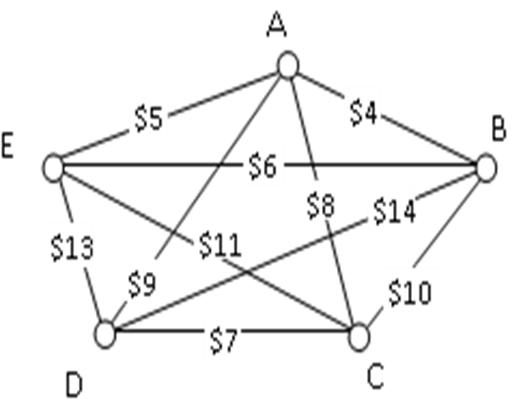
Kruskal’s Algorithm for Minimum Cost Spanning Trees:
List the edges of the graph, least to greatest.
Select the cheapest unused edge available which connects a new vertex but does not form a circuit (no closed loops). It is ok to have the degree of the vertex greater than two! (Unlike Cheapest Link).
Repeat until all vertices are connected in a spanning tree.

Slide 9
Use Kruskal’s Algorithm to find the cheapest way to connect the five offices.

Slide 10
The beauty of Kruskal’s Algorithm for MSTs is that it is both optimal and efficient. We are guaranteed to always produce the optimal spanning tree.
You can imagine that for a MaxST, we follow the same process but always choose the largest edge available.

Slide 11
Try this one: A power company wants to find the cheapest way to connect ten Oregon cities to the power grid. What are we looking for?
Draw a graph to keep track of the edges you have used…
 | Ashland | Astoria | Bend | Corvallis | Crater Lake | Eugene | Newport | Portland | Salem | Seaside
Ashland | - | 374 | 200 | 223 | 108 | 178 | 252 | 285 | 240 | 356
Astoria | 374 | - | 255 | 166 | 433 | 199 | 135 | 95 | 136 | 17
Bend | 200 | 255 | - | 128 | 277 | 128 | 180 | 160 | 131 | 247
Corvallis | 223 | 166 | 128 | - | 430 | 47 | 52 | 84 | 40 | 155
Crater Lake | 108 | 433 | 277 | 430 | - | 453 | 478 | 344 | 389 | 423
Eugene | 178 | 199 | 128 | 47 | 453 | - | 91 | 110 | 64 | 181
Newport | 252 | 135 | 180 | 52 | 478 | 91 | - | 114 | 83 | 117
Portland | 285 | 95 | 160 | 84 | 344 | 110 | 114 | - | 47 | 78
Salem | 240 | 136 | 131 | 40 | 389 | 64 | 83 | 47 | - | 118
Seaside | 356 | 17 | 247 | 155 | 423 | 181 | 117 | 78 | 118 | -

Slide 12
A system of roads is to be built between six condos in a complex. The developer wants to connect the complexes with as few roads as possible. What are we looking for? Solve it.
How does this differ from our TSP where the UPS driver had to visit all of the cities?

Slide 13
A bonus…..Searching trees
Remember the game 20 questions? A small handheld computer which asked questions to which you answer “yes” or “no”. Miraculously, after 20 questions, this device almost always guessed what you were thinking (or pretty close to it).
Pick a number between 1 and 100, inclusive. How many guesses do you think it will take me to get it right, guaranteed? (not counting chance)

Slide 14
How many questions for guessing a number between….
Range | # Questions
1 - 100
7
1 - 1,000
10
1 - 10,000
14
1 - 100,000
17
1 - 1,000,000
20
Notes:
7, 10, 14, 17, 20

Slide 15
Sources:
College Mathematics for Everyday Life, Kathryn Kozak et al (Coconino Community College) CC-BY-SA,
http://www.coconino.edu/resources/files/pdfs/academics/arts-and-sciences/MAT142/Chapter_6_GraphTheory.pdf
Math in Society, David Lippman, CC-BY-SA, http://www.opentextbookstore.com/mathinsociety/

